Slide 1
Anomaly Detection of Building Energy Consumption using Forecasting Techniques
Spring 2019, AE Research Project Proposal
ASDL, Georgia Institute of Technology
Kunal Sharma. January 25, 2019

Slide 2
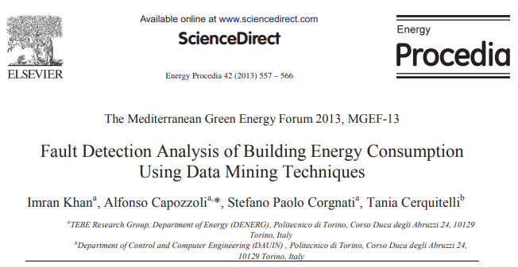
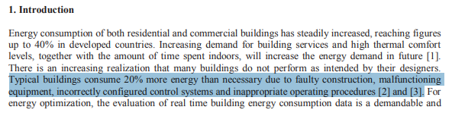
Problem Statement
“Typical Buildings Consume 20% more energy than necessary due to faulty construction, malfunctioning equipment, incorrectly configured control systems and inappropriate operating procedures.” – Mediterranean Green Energy Forum
Can we identify faults/anomalies using machine learning techniques?

Slide 3
High-Level Road Map
1. Manipulate Data to be Stationary
2. Create Forecasting Model
3. Obtain Residual Distribution
4. Flag Points with Z-Score above Threshold

Slide 4
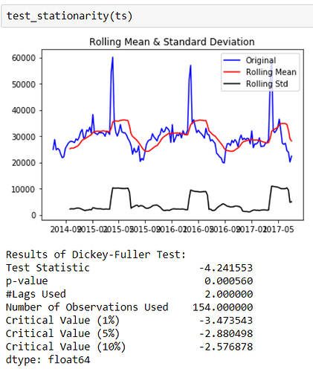
Step 1: Stationary Data
Forecasting techniques work the best when the data is stationary, in other words the mean and variance of the data should be constant.
Techniques such as transformations (typically log) and differencing are used.
We can test if the data is stationary using the Dickey-Fuller Test (Common Practice).

Slide 5
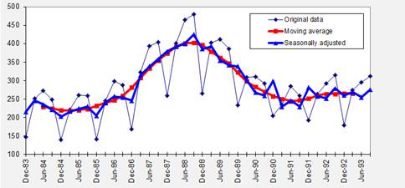
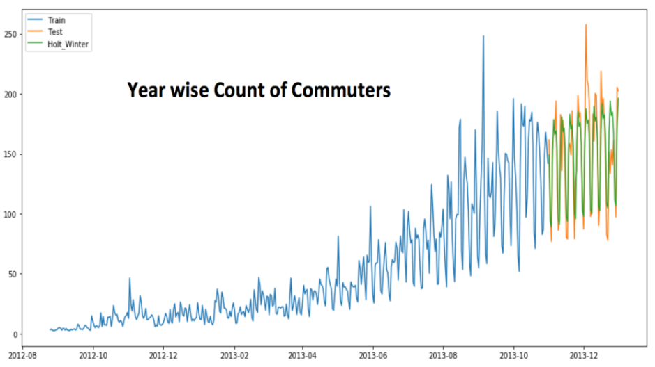
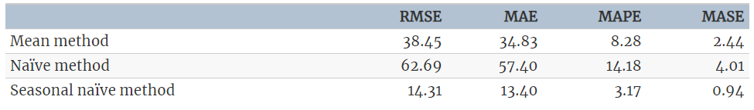
Step 2: Forecasting Model
A forecasting model such as ARIMA will gives us a model that will predict the energy consumption for a given building by taking into account trend and seasonality.
Possible Univariate Forecasting Models:
ARIMA
S-ARIMA
Holts Winter Method
Moving Average
Exponential Smoothing
ANN/RNN
Evaluation Metrics: MSE, RMSE, MAE, MAPE

Slide 6
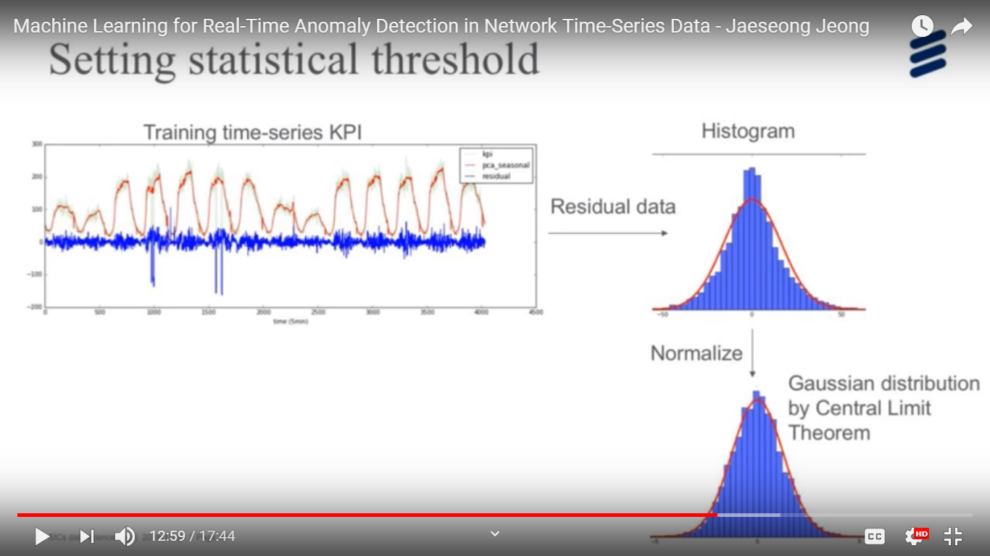
Step 3: Obtain Residual Distribution
The difference between the forecast model’s prediction and the true value is the residuals.
These residuals follow a Gaussian distribution (by the Central Limit Theorem).
Residual Data

Slide 7
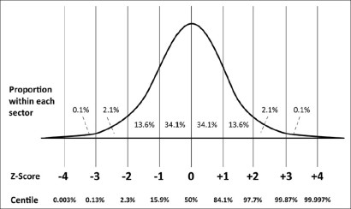
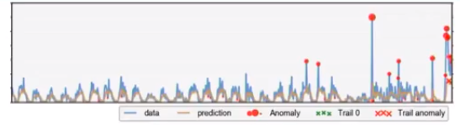
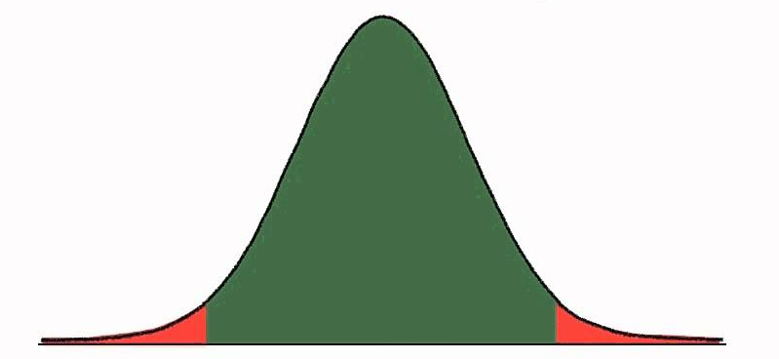
Step 4: Flag Points with a Z-Score Above Threshold
Extremely large positive or negative residuals are unlikely and will have a highly negative or positive Z-Score Value.
Flag Points Above or below set Z-Score thresholds
Z-Score tells us the magnitude and direction of the anomaly
ALERTS DASHBOARD
Anomalies

Slide 8
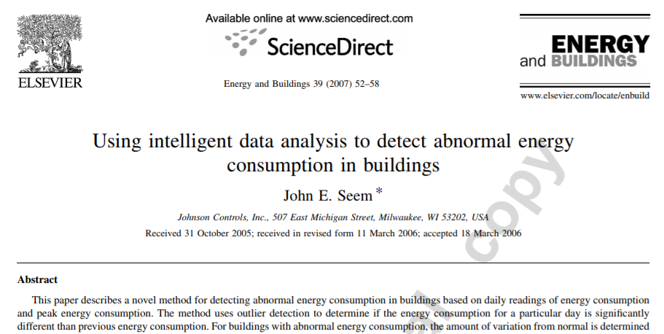
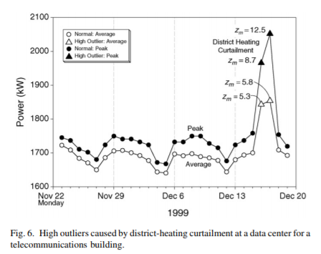

*Step 5: Alternative to Forecasting, Generalized Extreme Studentized Deviate Test (GESD) (+CART)
Method that uses robust statistical methods to determine anomalies. Has been applied to energy consumption data.
Uses the data points and statistics to give Z-scores to points, same threshold principle can be used
Ensemble Anomaly Detection

Slide 9
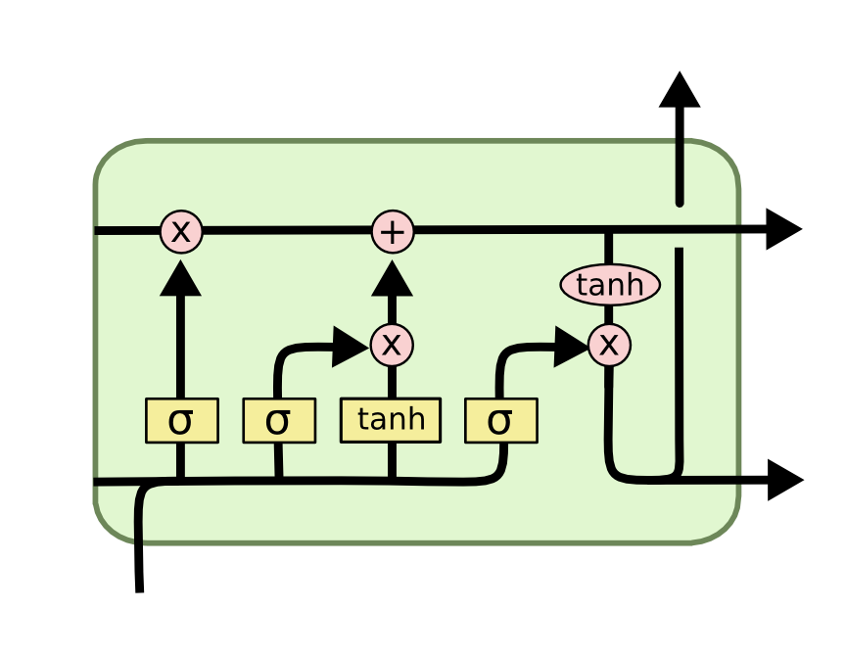
*Step 6: Multivariate Time Series Anomaly Detection
Forecasting Models presented previously are to detect anomalies given only the time data (independent) and one dependent variable (energy usage)
With Multivariate Forecasting Models we can include additional information such as temperature, humidity, wind speed, etc.
Multivariate Forecasting Models:
VARMA
LSTM

